Slide 1
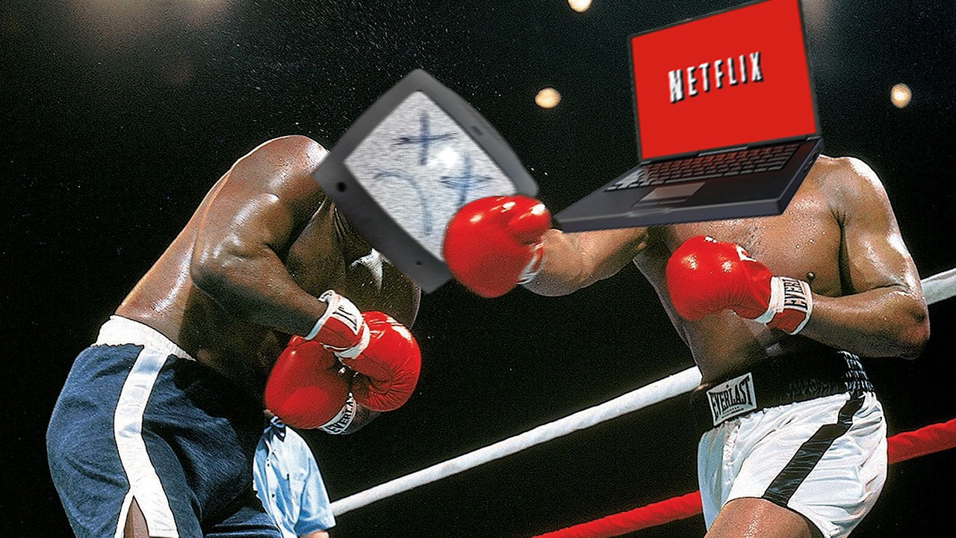
CABLE vs NETFLIX
A PRESENTATION BY “ORBIT”
ANAM MD ISFAQ
DIP FAZLA IMAM
RAHMAN MOHAIMENUR
SHIFA JANNATUN NUR
KANTA MARIA AKTER

Slide 2
OUTLINE:
1.Cable
2.Netflix
3.Advantage of cable
4.Advantage of Netflix
5.Disadvantage of cable provider
6.Disadvantage of Netflix
7.Why Netflix is better than cable?
8.conclusion

Slide 3
CABLE
Cable television is a system of delivering television program to subscribers via radio frequency. It offers us shows more than we need. We can choose between them which one is our favorite.

Slide 4
NETFLIX
Netflix is a "Watch Instantly" Internet video streaming service . Netflix allows users to chose from thousands of movie titles as well as entire seasons of Television show to watch on our computers, mobile devices, tablets. In North America alone, 24% of all internet streaming content comes from Netflix, which shows us that how popular this service truly is.

Slide 5
ADVANTAGE OF CABLE
Cable provider is just as important as deciding what to watch in this new golden age of television .Cable offers you local news ,live sports, daily series and just released films on DVD. It also offers you dozens of channels airing dozens of popular year old and classic films. There’s more selection with cable, although that will depend on the cable package you choose.

Slide 6
ADVANTAGE OF NETFLIX
Netflix is really complementary to cable. Netflix series are released all at once. So you don’t have to wait a week or more for episodes .It doesn’t really on advertising. Netflix is not expensive at all. We can watch Netflix endlessly at our house. We prefer to keep entertainment in our house pocket and Netflix helped us to do that.

Slide 7
DISADVANTAGE OF CABLE PROVIDER
Annoying Monopolies
Many areas only have a single cable television provider and this creates a monopoly.
CONFUSING PRICE PACKAGE
Many cable companies are very confusing when it come to how much their service will actually cost in the long run.

Slide 8
DISADVANTAGE OF NETFLIX
OUTDATED LIBRARY
Not only Netflix add the latest television show episodes and new movies right away its library is pretty much outdated.
DEPANDS ON YOUR LOCATION
For me, this is the biggest flow of Netflix. If you live in the United States, selection of movies and television shows is great. If not, you will probably be pretty disappointed with the offer.

Slide 9
Why Netflix is better than Cable?
Cable TVs are just like Dinosaurs who are on the verge of extinct. Also you cannot carry your cable TV everywhere with you restricting your area of viewing. Yes, there still many shows, which we can only watch on TV, but there are much more & great content provided by Netflix. Today Netflix is one of the most popular streaming site.

Slide 10
CONCLUSION
What side are you on? Do you still watch tv using cable? It is 2019 and lets got it straight the internet and cable isn’t what is used to be. Now you can stream your tv shows online with a subscription to Netflix. The difference between streaming online and watching cable is that you would have to wait until the provider upload the shows. On cable new episodes will appear on your tv right when they are scheduled . So we should suggest you all to use Netflix for better and easy life.

Slide 11
THANK YOU

